Slide 1
Getting Results with Spectrum
October 2019

Slide 2
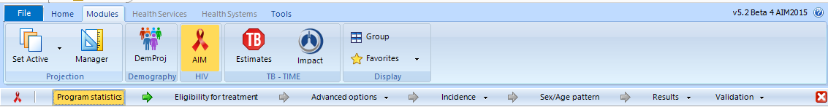
Reviewing Default Assumptions

Slide 3
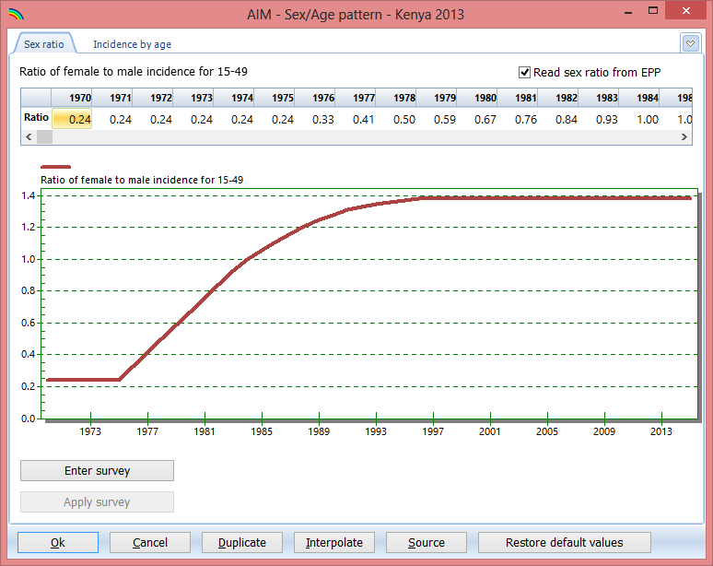
Female / Male Ratio of Incidence

Slide 4
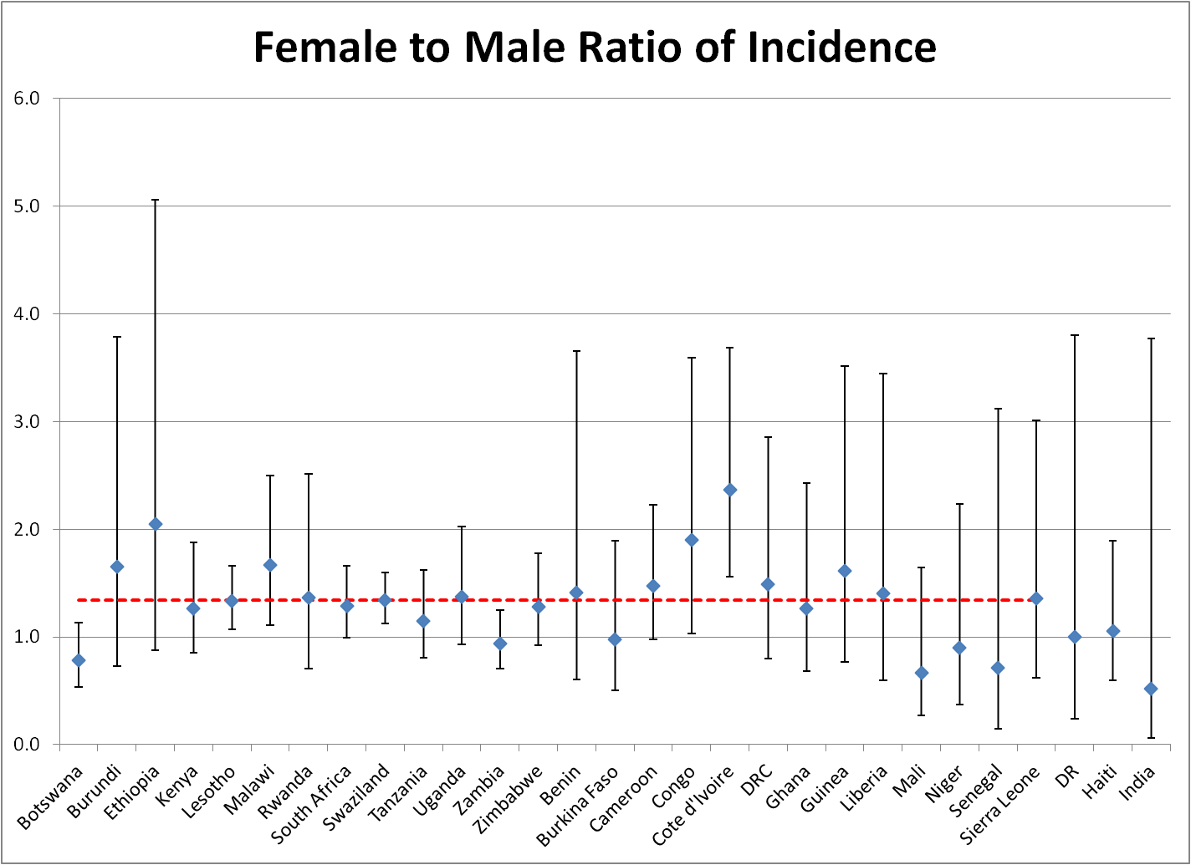
Sex Ratio of Incidence
1.38 – Generalized
0.42 - Concentrated

Slide 5
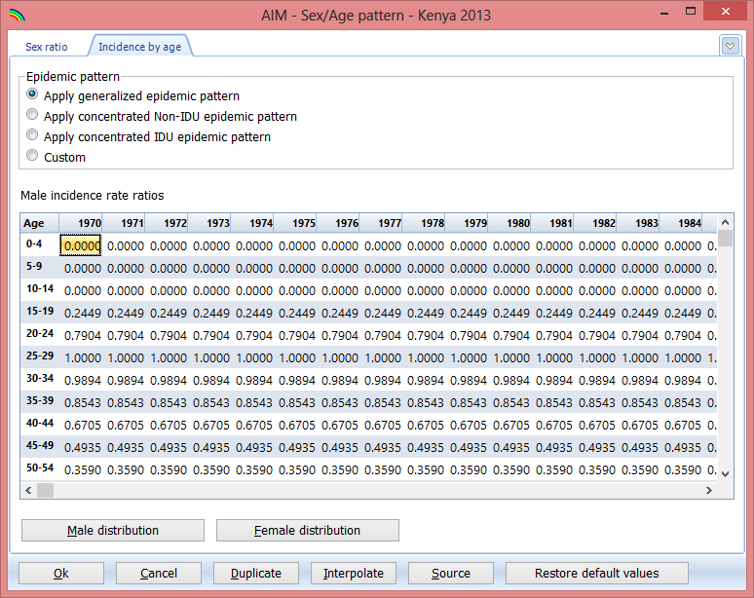
Incidence Rate Ratios by Age

Slide 6
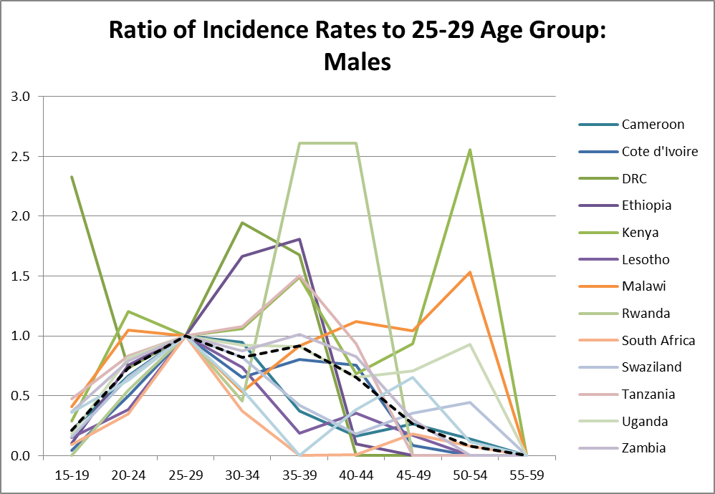
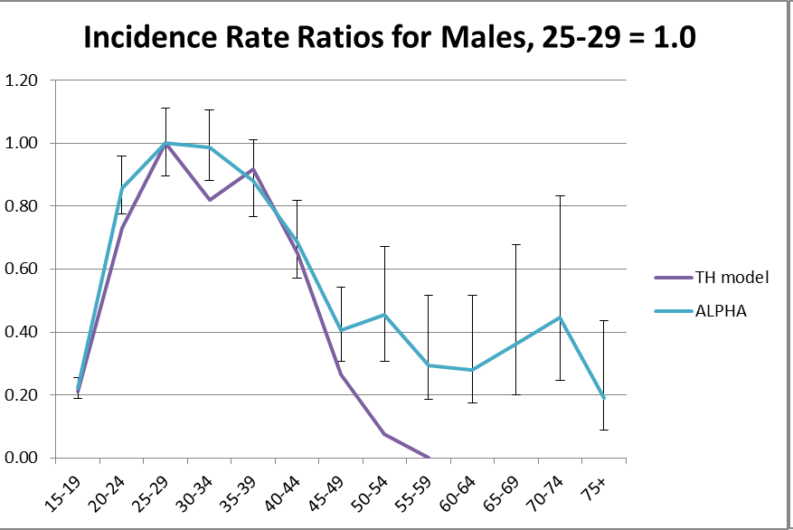
Incidence Rate Ratios
Estimate Incidence Pattern from National Prevalence Surveys
Compare to Incidence Pattern from ALPHA Network
Hallett TB, Stover J, Mishra V, Ghys PD, Gregson S, Boerma T. Estimates of HIV incidence from household-based prevalence surveys AIDS 2010; 24:147-52.
Basia Zaba, Age-Specific Patterns of Incidence: ALPHA sites, 1995-2010, presented at UNAIDS Reference Group Meeting, Dec 5, 2012, Geneva.

Slide 7
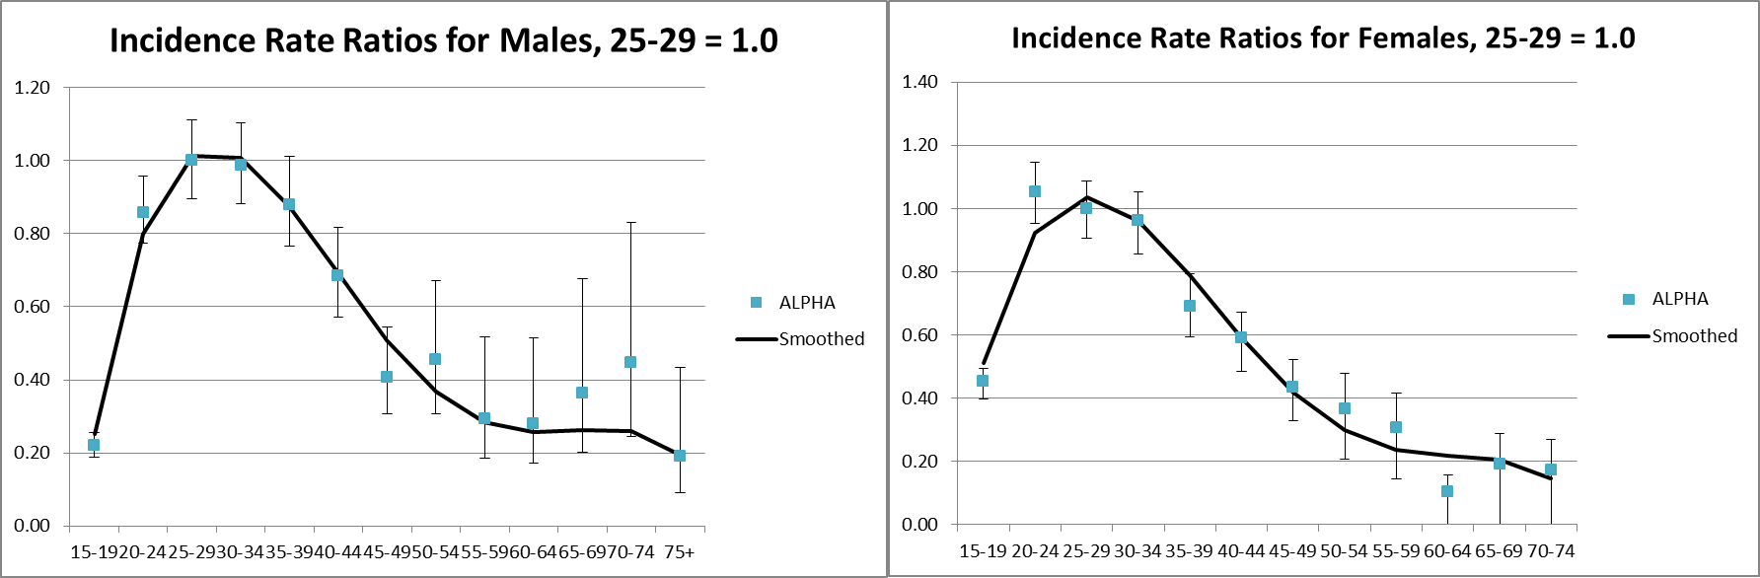
Incidence Rate Ratios: Generalized Epidemics

Slide 8
Age Patterns of Incidence: Concentrated Epidemics
Males
Female

Slide 9
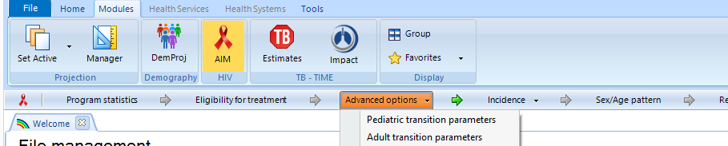
Reviewing Default Assumptions
Progression by CD4 category
Distribution of new infections by CD4 category
HIV mortality without ART
HIV mortality with ART
Fertility reduction due to HIV-infection
Treatment effectiveness for children
Progression of HIV in children

Slide 10
Tracking New Adult HIV Infections
New Infections
>500
350-499
250-349
200-249
100-199
50-99
<50
On ART
μ₁
c₁
α₁
>500
μ₂
λ₁
c₂
α₂
350-499
μ₃
λ₂
c₃
α₃
250-349
μ₄
λ₃
c₄
α₄
200-249
μ₅
λ₄
c₅
α₅
100-199
μ₆
λ₅
c₆
α₆
50-99
μ₇
λ₆
c₇
α₇
<50
AIDS Death

Slide 11
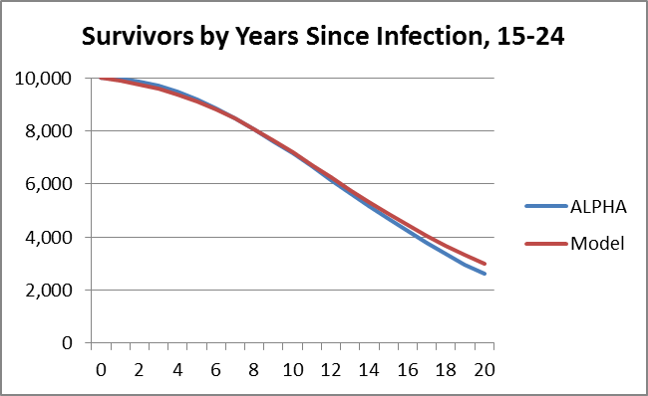
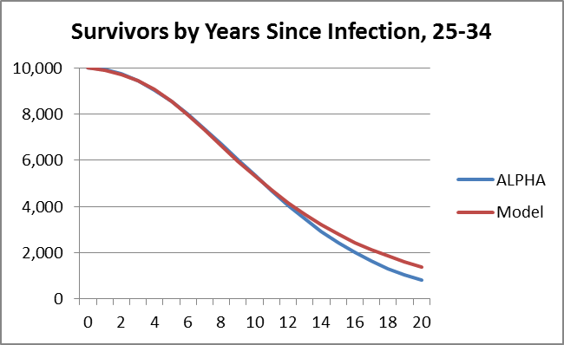
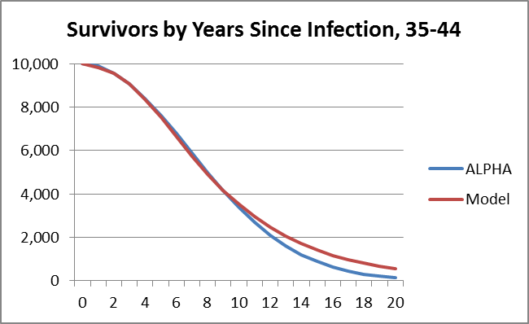
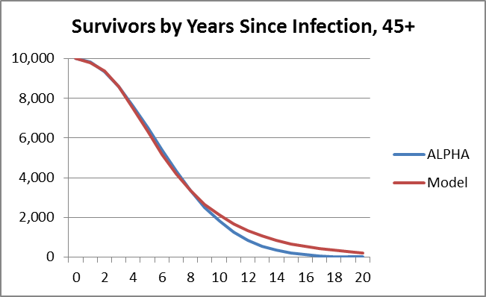
Progression and Mortality Rates Selected to Fit Survival Patterns
Todd et al. Time from HIV seroconversion to death: a collaborative analysis of eight studies in six low and middle-income countries before highly active antiretroviral therapy AIDS 2007, 21 (suppl 6):S55-63.

Slide 12
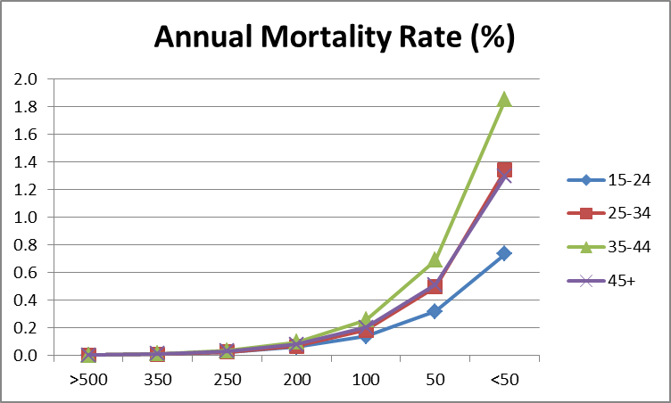
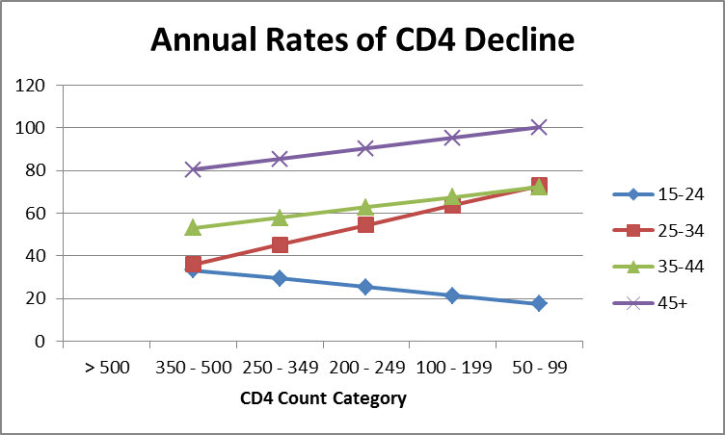
Mortality and Progression by CD4 Count
HIV-Related Mortality without ART
CD4 Count Progression Rates

Slide 13
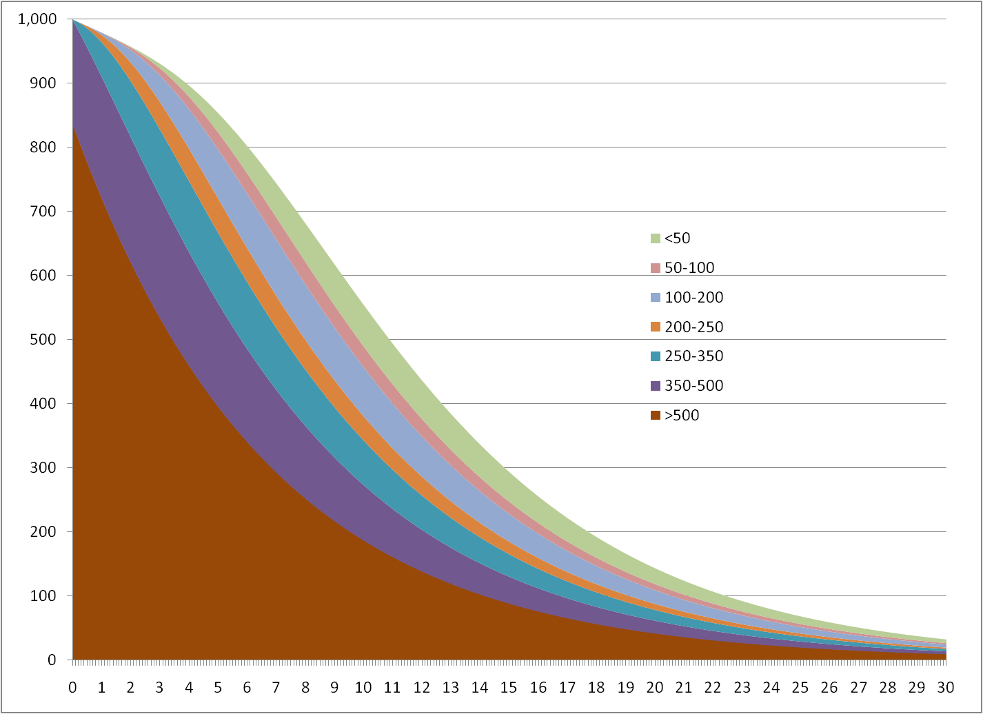
Evolution of Cohort of New Infections

Slide 14
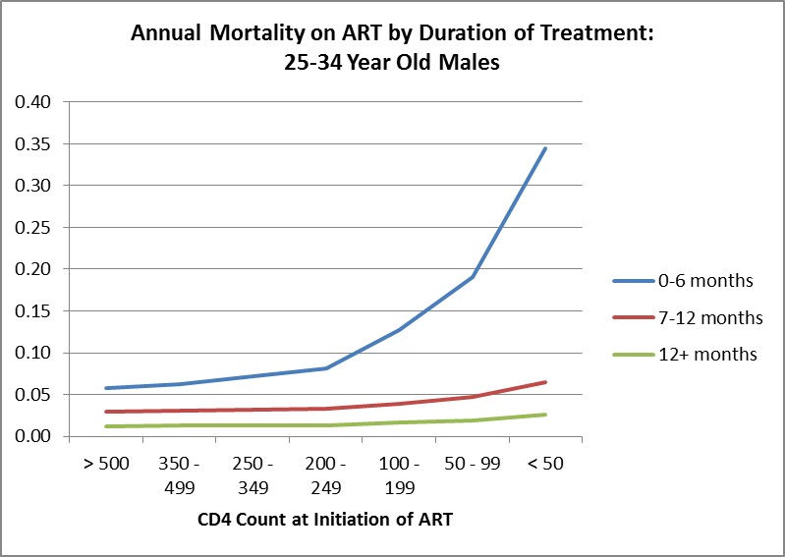
Mortality on ART by CD4 Count at Initiation by Duration
Adapted from Yiannoutsos et al. Estimated mortality of adult HIV-infected patients starting treatment with combination antiretroviral therapy Sex Transm Infect 2012;88:i33-i43.

Slide 15
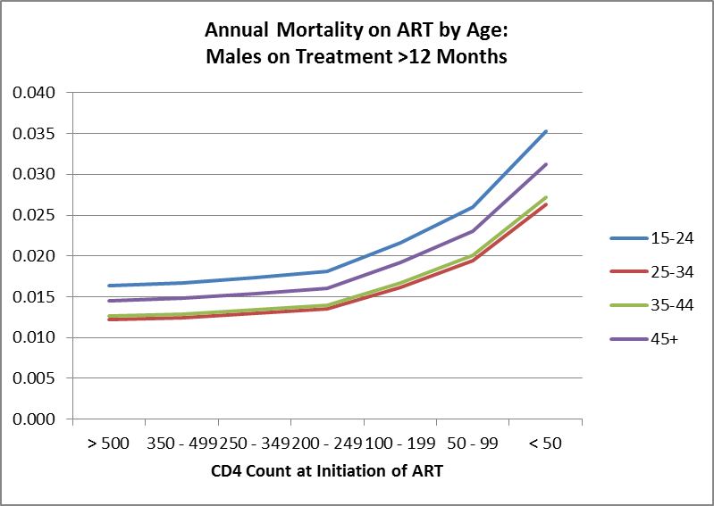
Mortality on ART by CD4 Count at Initiation by Age
Adapted from Yiannoutsos et al. Estimated mortality of adult HIV-infected patients starting treatment with combination antiretroviral therapy Sex Transm Infect 2012;88:i33-i43.

Slide 16
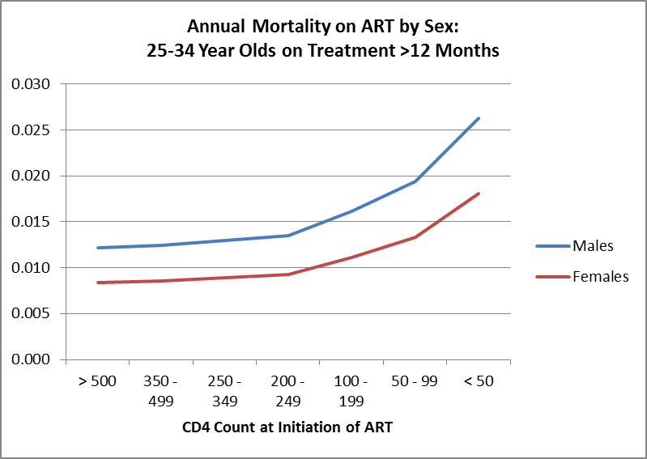
Mortality on ART by CD4 Count at Initiation by Sex
Adapted from Yiannoutsos et al. Estimated mortality of adult HIV-infected patients starting treatment with combination antiretroviral therapy Sex Transm Infect 2012;88:i33-i43.

Slide 17
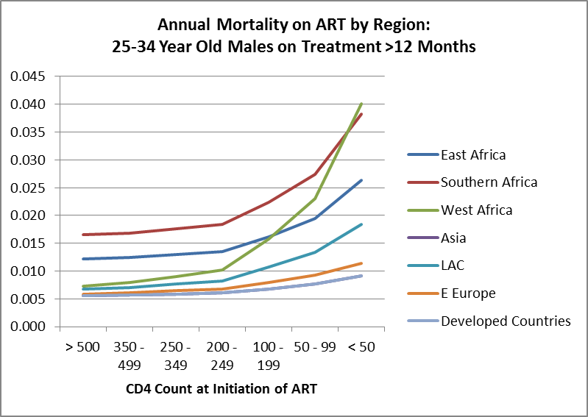
Mortality on ART by CD4 Count at Initiation by Region
Adapted from Yiannoutsos et al. Estimated mortality of adult HIV-infected patients starting treatment with combination antiretroviral therapy Sex Transm Infect 2012;88:i33-i43.

Slide 18
Pediatric Model Tracks Infections by CD4 Category and Timing of Infection
Children 0-4: CD4 percent
Children 5-14: CD4 count
>30
26-30
21-25
16-20
11-15
5-10
<5
>1000
750-999
500-749
350-499
200-349
<200
Timing of infection: Perinatal, 0-6 months, 7-12 months, 12+ months after birth

Slide 19
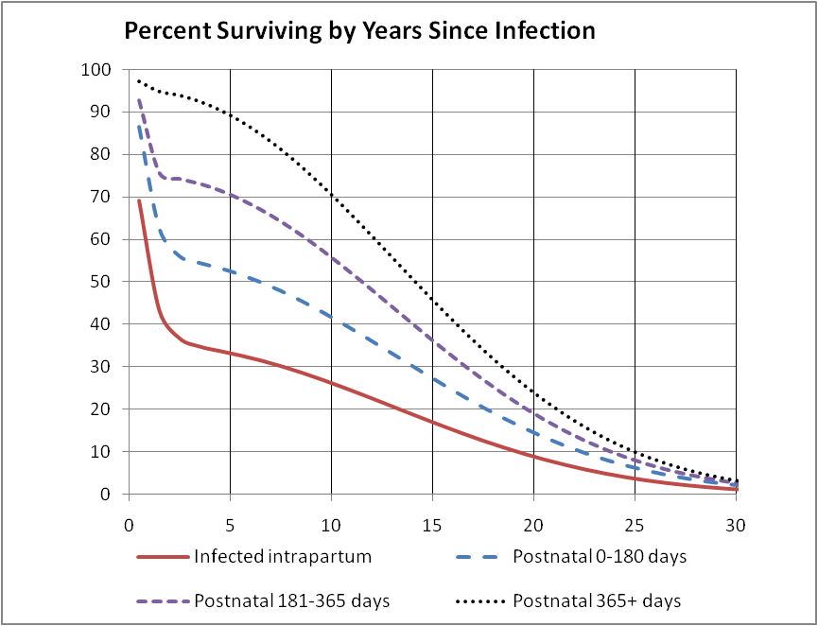
Child HIV-Related Mortality
Marston M, Becquet R. Net survival of children HIV-infected perinatally and through breastfeeding: a pooled analysis of individual data from resource-constrained settings, December 2010.

Slide 20
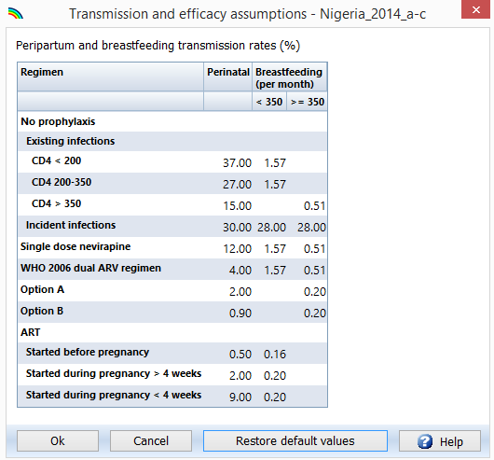
Mother-to-Child Transmission
Rollins et al. Estimates of peripartum and postnatal mother-to-child transmission probabilities of HIV for use in Spectrum and other population-based models Sex Transm Infect 2012;88:i44-i51.
Preliminary results from the PROMISE Study

Slide 21
Fertility Effects of HIV Infection
Box Plots of Ratio of Age-Specific Fertility Rates for HIV+ to HIV- Women for 20 Countries with a DHS
Wei-ju Chen, Neff Walker Fertility of HIV-infected women: insights from Demographic and Health Surveys Sex Transm Infect 2010;86:ii22-ii27.
Notes:
Wei-ju Chen and Neff Walker analyzed data from 20 DHS data sets to calculate the ratio of age-specific fertility among HIV+ and HIV- women. This box plot shows their results.

Slide 22
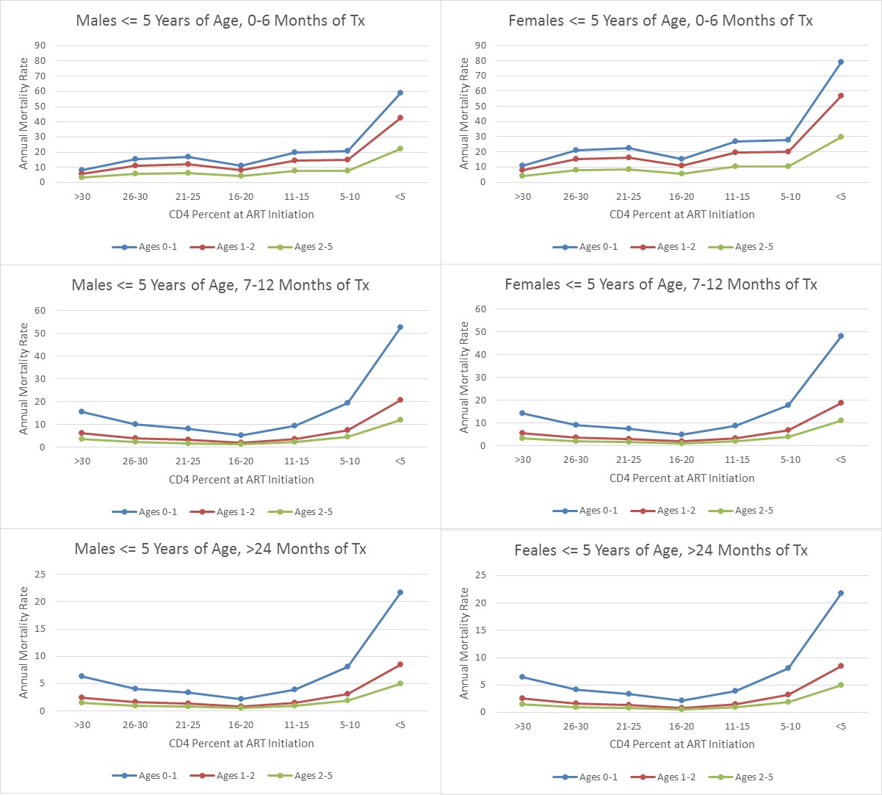
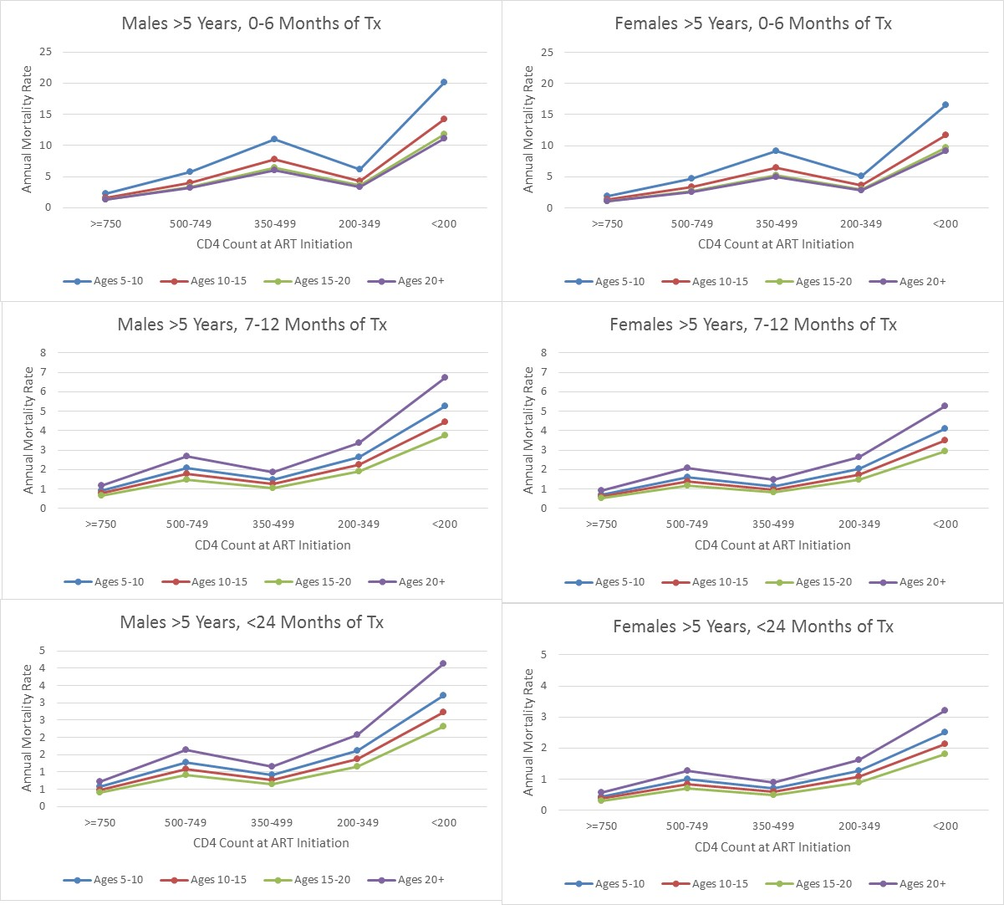
Effects of Pediatric ART from IeDEA Consortium

Slide 23
Results: Key Output Indicators
Indicators
HIV+ population
New infections
HIV-related deaths
Need for ART
Need for PMTCT
Orphans
Population Groups
All ages
Adults 15-49
Adults 15+
Young people 15-24
Pregnant women
Children 0-14
Children 0-1
Children 1-4
Children <2
Regions

Slide 24
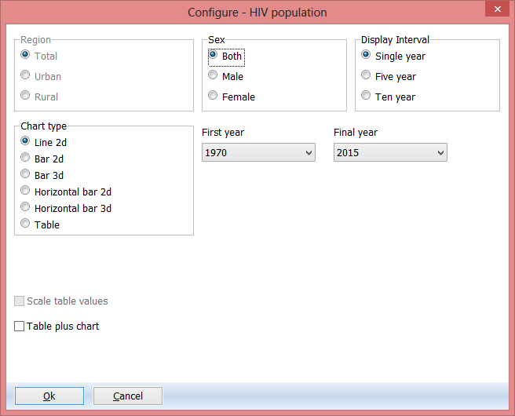
Display Options

Slide 25
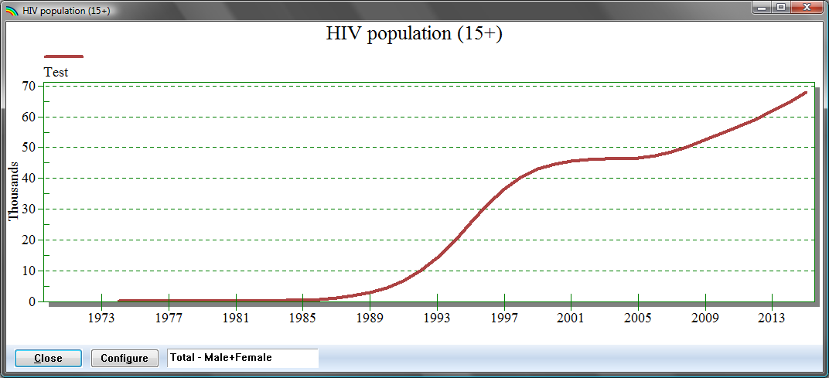
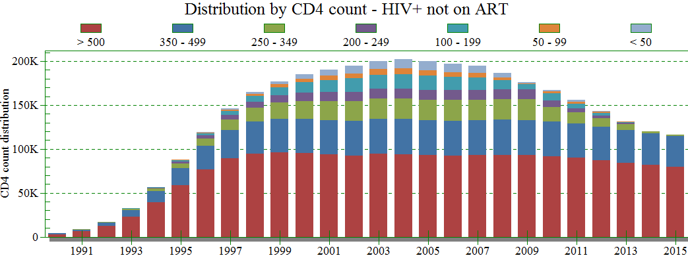
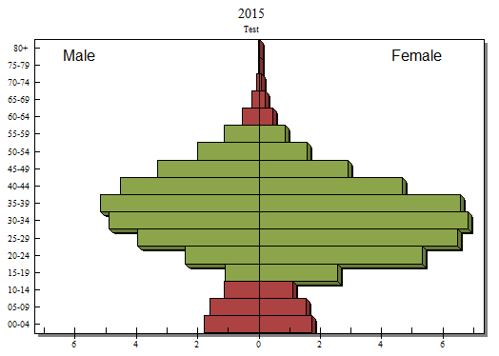
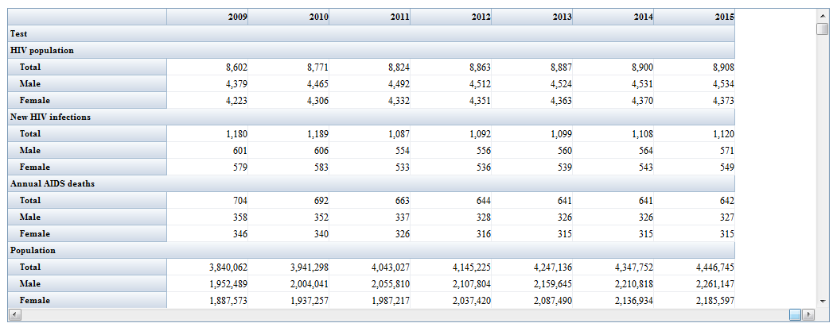
Display Options
Summary Table

Slide 26
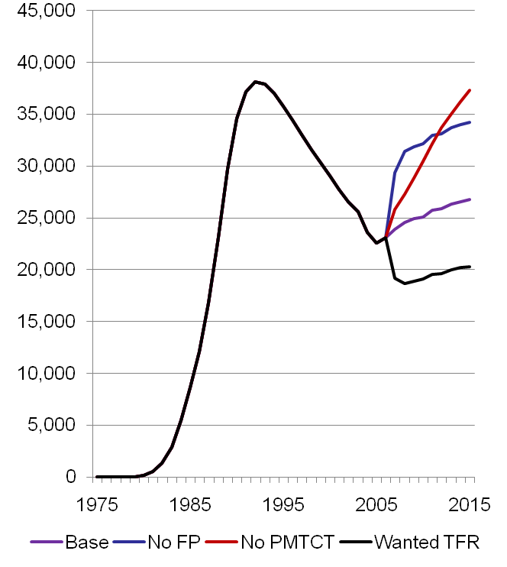
Display Multiple Projections
Up to 10 projections can be open at on time
To create alternate projections
Open the same projection twice
Rename the second projection
Edit the second projection

Slide 27
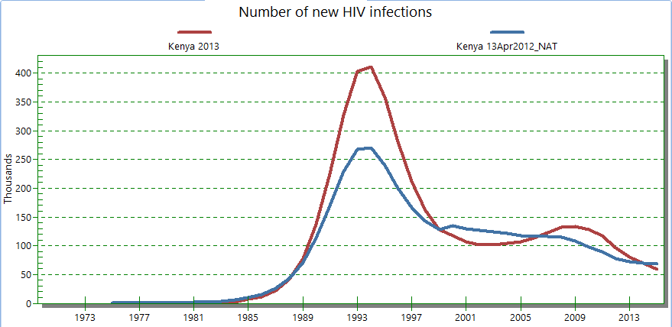
Open a Comparison Projection to Compare New Results to 2013 Estimate
Comparison Projections can be viewed but not changed and will not re-project.

Slide 28
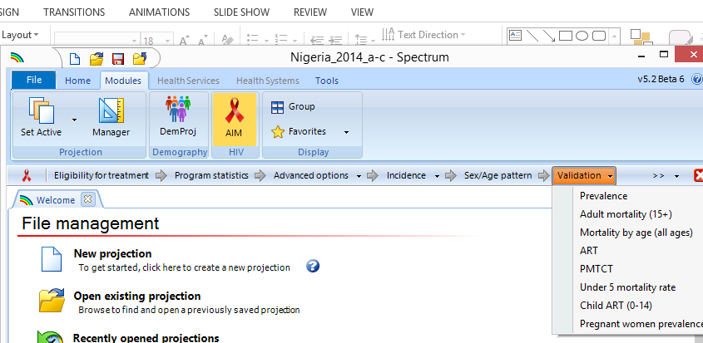
Validation

Slide 29
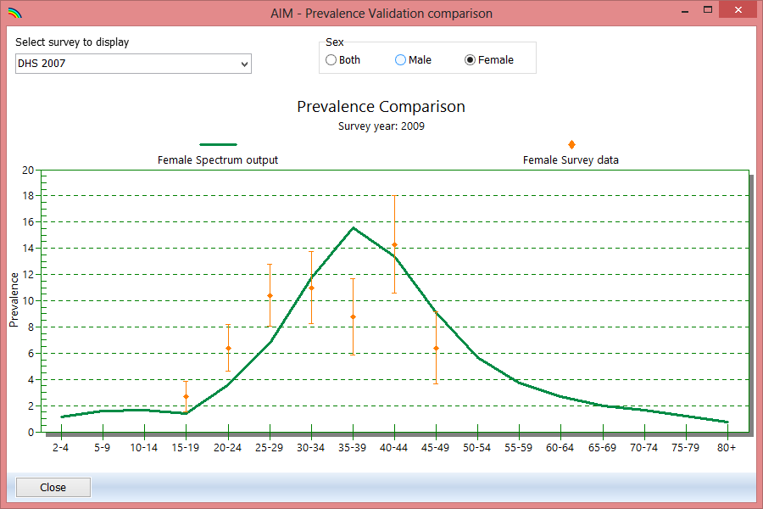
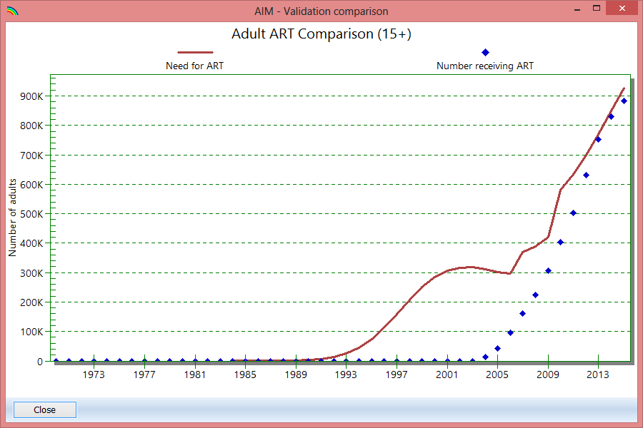
Validation

Slide 30

Tools Menu
You can choose a number of projections (which could be sub-national projections) and add them together

Slide 31
Tools Menu

Slide 32
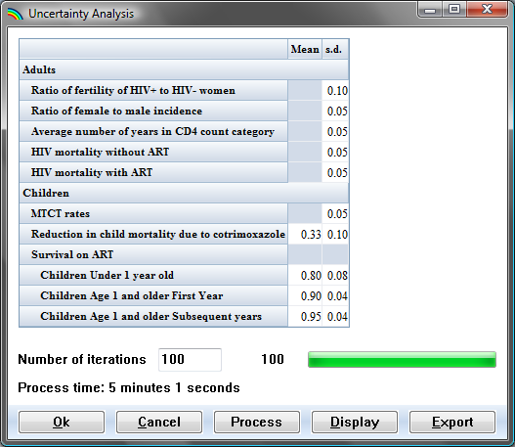
Uncertainty Analysis

Slide 33
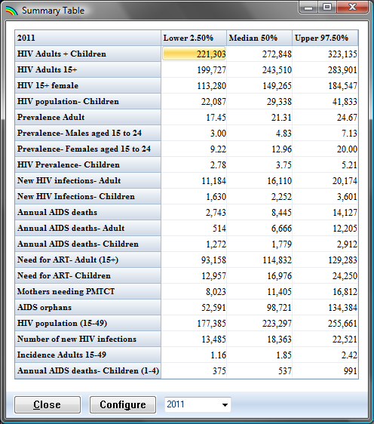
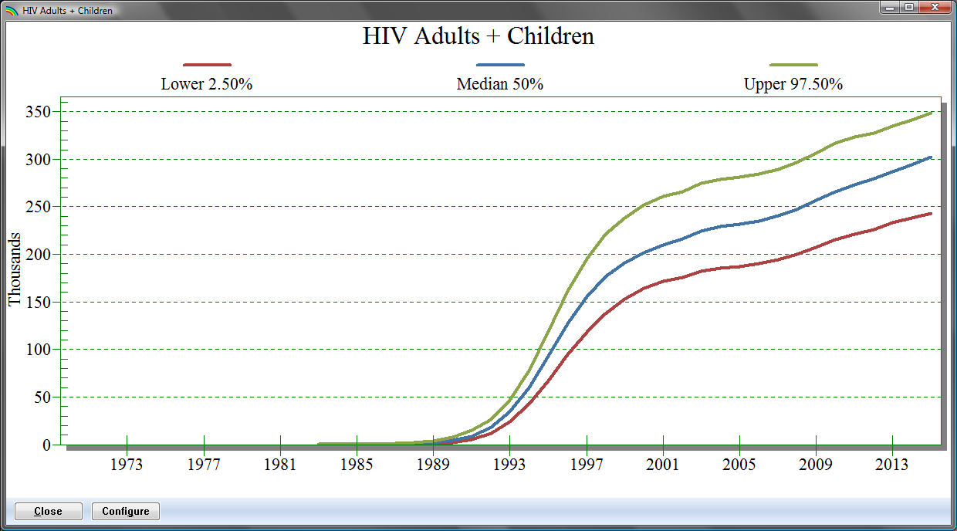
Uncertainty Analysis

Slide 34
Hands-On Session
Open your Spectrum country file
View the Sex/Age and Advanced Options to ensure that appropriate patterns are selected for your region and epidemic type
View results
Compare to previous projection
Examine Validation charts
Calculate uncertainty analysis
SAVE YOUR FILE!

